Slide 1


Analysis of US Traffic Accidents from Dec 2016 – Dec 2019
Vipul Aggarwal
Kannika Phadoungxath
Liliana Joya

Slide 2


Index
Data introduction
Initial questions
Data-cleaning process
Findings
Conclusions
For further analysis

Slide 3
Dataset: U.S. Traffic Accidents
We explored data on U.S. accidents from 2016 to 2020 with approximately 3 million recorded accidents. The dataset includes accidents in the 49 contiguous states.
The dataset was collected in real time and includes factors associated with the accidents, such as location, time, weather conditions and severity of accidents, among others.
We used US Census Data for population density analysis and Google Maps API for plotting.
Citations:
Moosavi, Sobhan, Mohammad Hossein Samavatian, Srinivasan Parthasarathy, and Rajiv Ramnath. “A Countrywide Traffic Accident Dataset.”, 2019.
Moosavi, Sobhan, Mohammad Hossein Samavatian, Srinivasan Parthasarathy, Radu Teodorescu, and Rajiv Ramnath. "Accident Risk Prediction based on Heterogeneous Sparse Data: New Dataset and Insights." In proceedings of the 27th ACM SIGSPATIAL International Conference on Advances in Geographic Information Systems, ACM, 2019.

Slide 4
Initial Questions
How severe* are the accidents in terms of impact on traffic?
What states have the most accidents/least accidents? What about cities? Does population density factor in?
Does time play a role? Across the year, seasons, months, days, or hours? If so, to what extent?
Does weather play a role? If so, to what extent? What other environmental factors contribute to accidents?

Slide 5
Data-Cleaning Process
We reduced the number of variables to analyze by dropping columns that either had null values or were not relevant to the questions we wanted to answer.
Then we reduced our analysis to the past three recorded years, dropping all of 2016 except for the month of December to account for our Seasons analysis.
We grouped seasons into the following categories: Winter (Dec, Jan, Feb); Spring (Mar, Apr, May); Summer (Jun, Jul, Aug); Fall (Sept, Oct, Nov).
We simplified time by dropping the minutes and keeping the hours to analyze traffic accidents by hours of the day.
We grouped weather conditions into six broad categories: Clear, Rain, Fog, Snow, Sleet, Wind.

Slide 6
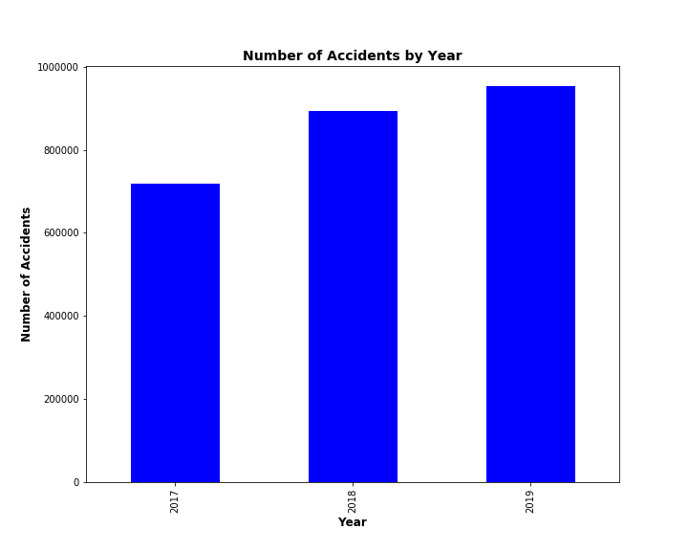
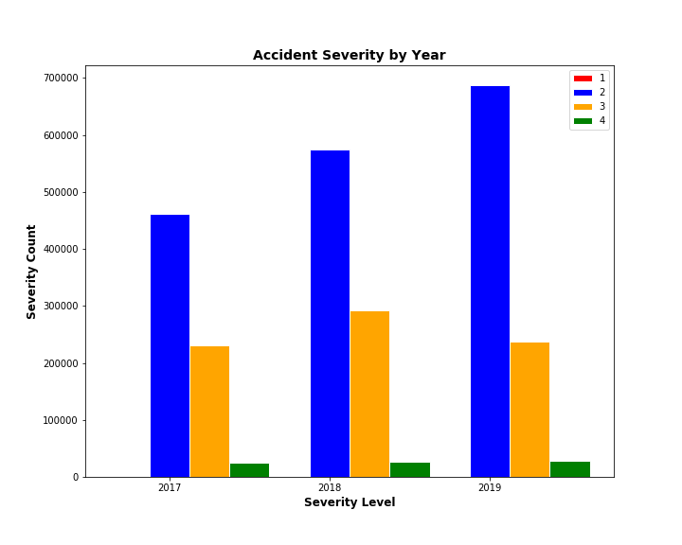
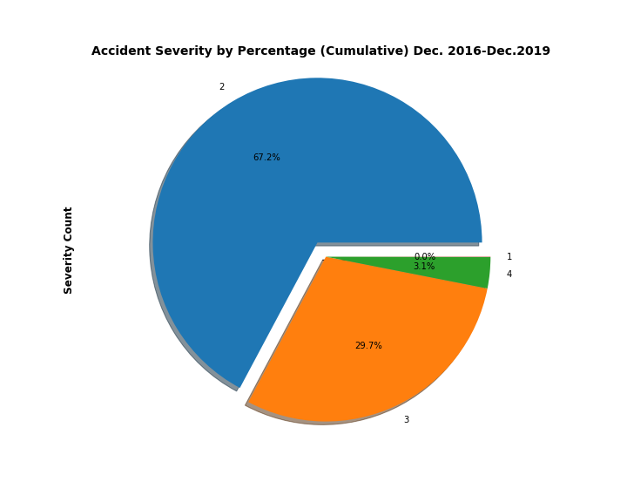
Traffic Accidents and Severity
In general, we saw a steady increase in the number of accidents per year countrywide.
Next, we looked into the severity of all accidents.
Note: Severity level = impact on traffic; a number between 1 and 4, where 1 indicates the least impact on traffic (i.e., short delay and 4 indicates high impact on traffic – length of impact has no relevance).
As shown, most accidents fall into moderate to slightly high impact on traffic, with most accidents (67%) falling into severity level 2.

Slide 7
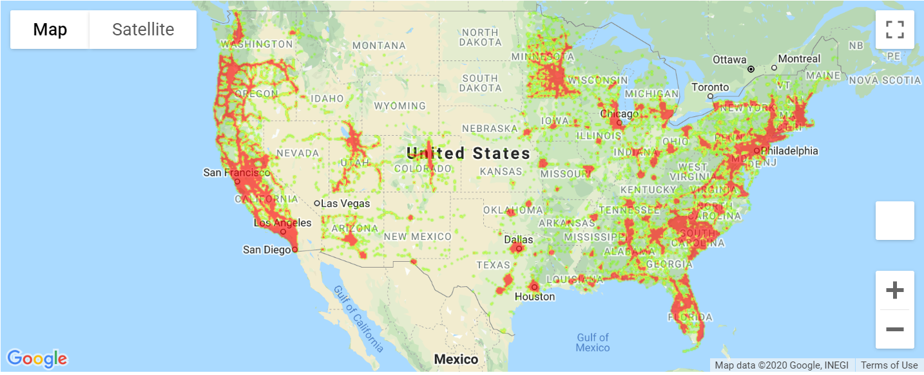
Traffic Accidents Across the US

Slide 8
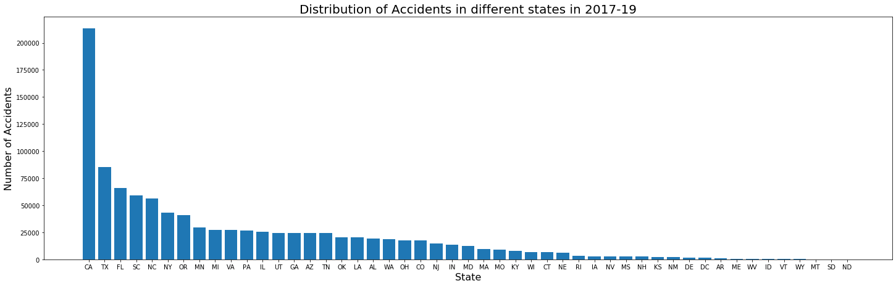
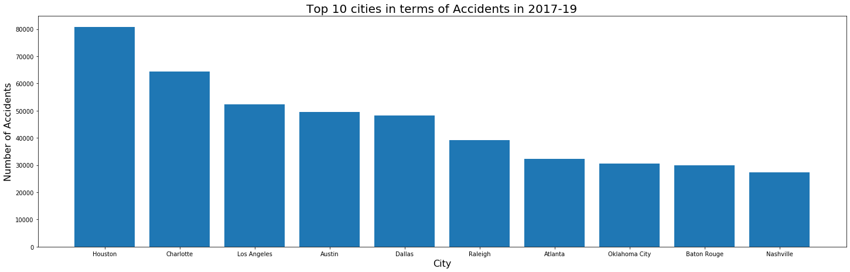
Traffic Accidents Across States and Cities
California surpassed other states significantly in the number of accidents across three years.
Interestingly, of the top 10 cities with the most accidents across three years, only one city in California is on the list. Three cities in Texas are on the list.

Slide 9
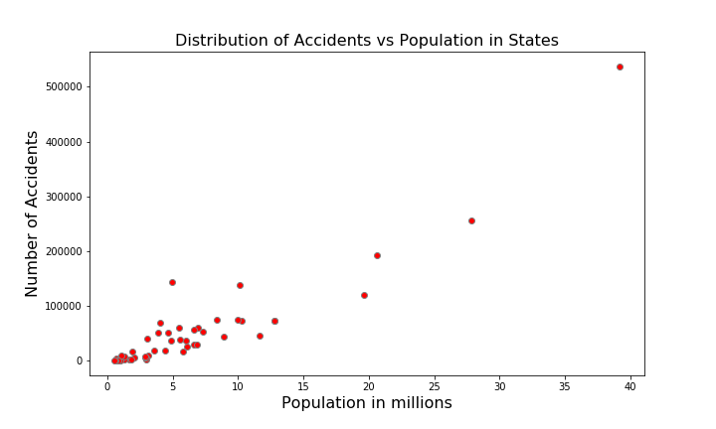
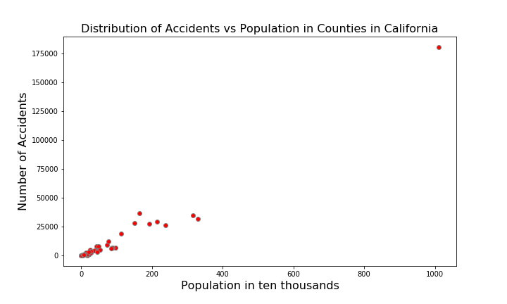
Traffic Accidents vs Population Density
States with a higher population density also had higher rates of accidents.
Looking further into the most populous state, California, we saw that counties with higher population densities also had higher rates of accidents.

Slide 10
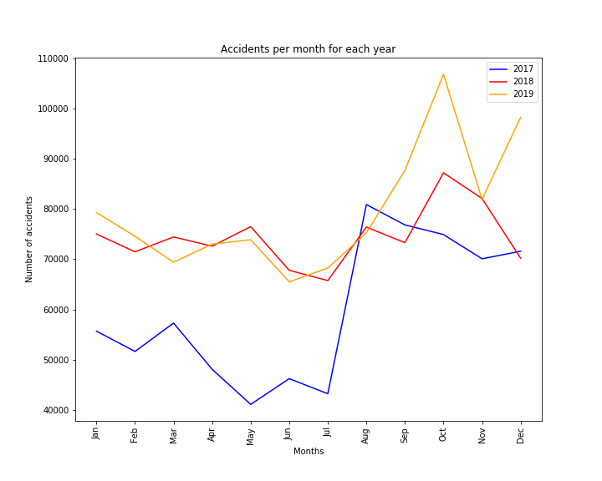
Time Analysis: Number of accidents throughout the year
Accidents per month for the years 2017, 2018 and 2019 show a slight increase in number of accidents in the later part of the year, starting August.

Slide 11

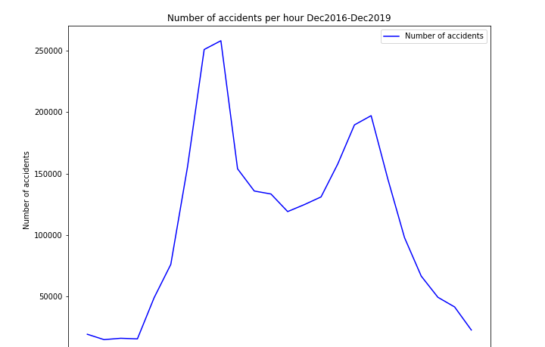
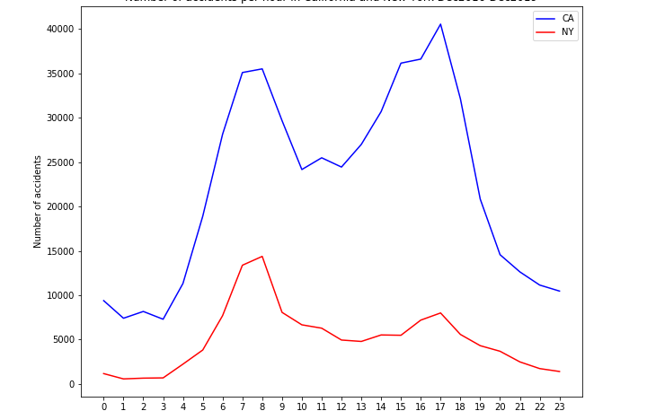
Time Analysis: What time of the day do accidents occur most?
Number of accidents was grouped by hour of the day
Results show an obvious peak in number of accidents during both the morning and evening rush hour
Same trend is followed by different states including California and New York

Slide 12
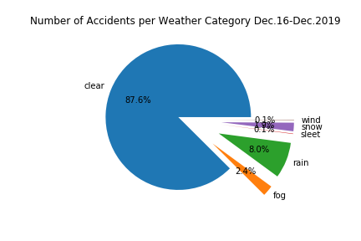
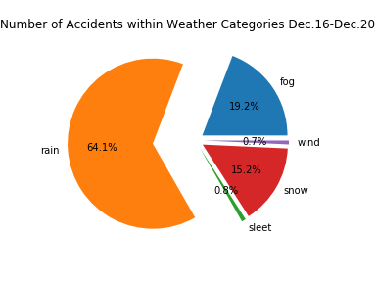
Weather Analysis
Weather categories were created for the accidents showing severe weather conditions.
Weather related accidents account at least to 12.4% of accidents in the US for the time period studied.
Within the weather categories created, rain accounts for 64.1 % of weather-related accidents.
Wet road accidents or sleek pavement have not been accounted for and need to be further studied.

Slide 13
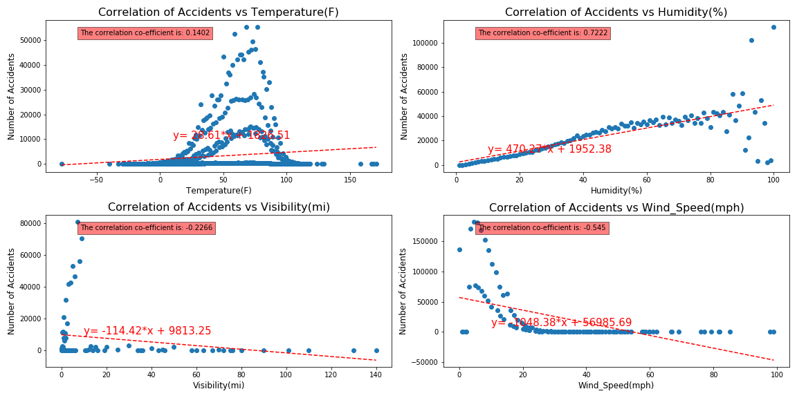
Environmental Factors on Traffic Accidents
Most of the accidents happen at visibility of 10 mi and same was removed from the dataset.
Rows of data with wind speed greater than 100 mph was removed.
Accidents have little correlation to temperature.
Accidents have a strong correlation to humidity
Accidents have a weak negative correlation to visibility
Accidents have a moderate negative correlation to wind speed.

Slide 14
Cumulative Impact of Factors on Traffic Accidents
We combined some of the environmental factors and tried to analyze the correlation of accidents with the factors combined.
The methodology used to combine the factors was to multiply the values within each feature to calculate a combined score.
The correlation between the combined score and number of accidents was calculated using Pearson’s correlation co-efficient method.
No correlation was found in the factors that were combined with this methodology.
Different modelling methodologies and other factors can be combined to analyze and determine impact of combination of factors to number of accidents.
 | First Factor Correlation Co-efficient | Second Factor Correlation Co-efficient | Combined Correlation Co-efficient
Temperature and Visibility | 0.1402 | -0.2266 | -0.0214
Humidity and Visibility | 0.7222 | -0.2266 | -0.0667

Slide 15
Conclusions
The number of accidents is directly related to the density of the populations, with more accidents happening in the most densely populated states. These accidents tend to be moderately severe in terms of impact on traffic.
Accidents tend to occur mostly during morning and evening rush hours with a notable peak in the number of accidents during those hours; for some cities with more traffic, this peak is more obvious.
Extreme weather could be causing approximately 13% of accidents in the US, although wet road accidents were not directly studied in this analysis.
This is further demonstrated by the correlation analysis, which shows a correlation between humidity and the number of accidents.
In general, human factors is a more likely cause of accidents as seen by our population density and time analyses, which lead us to conclude that the more cars are on the road, the more likely traffic accidents will occur.

Slide 16
For Further Analysis
Analyze the effects of extreme weather conditions on accidents during rush hour.
Look further into states with lesser number of accidents to analyze impact of weather conditions to accidents.
More models can be designed and applied to analyze cumulative impact of multiple factors on accidents.
Look into correlation of precipitation specifically, as rain is the most relevant weather factor on accidents.
Look into relation of severity level of accidents to length of impact on traffic.

